Slide 1
What are model organisms?
A model organism is a species that has been widely studied, usually because it is easy to maintain and breed in a laboratory setting and has particular experimental advantages.
Model organisms are non-human species that are used in the laboratory to help scientists understand biological processes.
They are usually organisms that are easy to maintain and breed in a laboratory setting. For example, they may have particularly robust embryos? that are easily studied and manipulated in the lab, this is useful for scientists studying development.
Or they may occupy a pivotal position in the evolutionary tree, this is useful for scientists studying evolution.?

Slide 2
Why are model organisms useful in genetics research?
Many model organisms can breed in large numbers.
Some have a very short generation time, which is the time between being born and being able to reproduce, so several generations can be followed at once
Mutants allow scientists to study certain characteristics or diseases. These are model organisms that have undergone a change or mutation in their DNA that may result in a change in a certain characteristic.
Some model organisms have similar genes or similar-sized genomes to humans.
Model organisms can be used to create highly detailed genetic maps:

Slide 3
Genetic maps are a visual representation of the location of different genes on a chromosome, a bit like a real map but one where the key landmarks are areas of interest in the genome.
For example, areas of DNA that differ between individuals in the same species (SNPs) or genes.
Examples of model organisms used to study genetics
Yeast (Saccharomyces cerevisiae)
Fruit fly (Drosophila melanogaster)
Nematode worm (Caenorhabditis elegans)
Western clawed frog (Xenopus tropicalis)
Mouse (Mus musculus)
Zebrafish (Danio rerio)
E. Coli

Slide 4
How are humans and yeast similar?
Yeasts cells, like ours, have a nucleus containing DNA packaged into chromosomes.
Most metabolic and cellular pathways thought to occur in humans, can be studied in yeast. For example, studying signalling proteins in yeast has advanced our understanding of brain and nervous system development.
Yeast cells divide in a similar manner to our own cells. In fact, it has been found that many of the genes? that work to regulate cell division in yeast, have equivalents that control cell division in higher organisms, including humans.

Slide 5
At least 20 per cent of human genes known to have a role in disease have functional equivalents in yeast. This has demonstrated that many human diseases result from the disruption of very basic cellular processes, such as DNA repair, cell division, the control of gene expression and the interaction between genes and the environment.

Slide 6
The Saccharomyces Genome Deletion Project
aimed to produce mutant strains of yeast in which each one of the 6,000 genes in yeast is mutated. From this it was hoped that the precise function of each gene could be identified.
In 2001, three scientists shared the Nobel Prize These three scientists were Leland Hartwell, Paul Nurse and Tim Hunt.

Slide 7
The discoveries of Leland Hartwell, Paul Nurse, Tim Hunt and others using yeast as a model organism, have contributed significantly to the generation of a universal view of how cell division is controlled in eukaryotic cells. This understanding has had broad applications within a number of different fields in biology, including the prevention, diagnosis and treatment of cancer.

Slide 8
Research using S. cerevisiae as a model organism has given hope to people with Parkinson’s disease. Parkinson’s disease and other neurodegenerative diseases such as Alzheimer’s and Huntington’s are characterised by protein misfolding, resulting in the build-up of toxic cells in the central nervous system.

Slide 9
What is E. coli?
E. coli is a Gram-negative rod-shaped bacterium which is typically around 1µm long and 0.35µm wide. It is able to survive with or without oxygen and thus is a “facultative aerobe”. While it is able to grow fast without forming clumps in various inexpensive chemically defined media, it is not typically tolerant to very high or low temperatures or extreme acidity/alkalinity

Slide 10
What discoveries were made using E. coli as a model organism?
Several key discoveries in the field of molecular biology, including molecular genetics, were achieved using E. coli as a model organism. This includes an understanding of the genetic code, the mechanisms of DNA replication, the discovery of the genetic operon systems, and the creation of a genetically modified organism.

Slide 11
E. coli and its use as a model organism in metabolic engineering
Because there are tools available to manipulate the genome of E. coli, it is a good candidate as a model organism for metabolic engineering; this is where E. coli is genetically manipulated so that it becomes able to produce desired chemicals from various sources during growth.

Slide 12
Plasmids; increasing the potential of E. coli as a model organism
Plasmids are fragments of DNA separate from the chromosome, which can replicate itself. The main components of plasmids include the origin of replication and a selection marker such as a gene conferring antibiotic resistance. These plasmids can be manipulated, so a new phenotype can be conferred to E. coli strains by the incorporation of these modified plasmids.

Slide 13
Key Concepts:
E. coli is a preferred host for gene cloning due to the high efficiency of introduction of DNA molecules into cells.
E. coli is a preferred host for protein production due to its rapid growth and the ability to express proteins at very high levels.
Bacterial conjugation can be used to transfer large DNA fragments from one bacterium to another.
E. coli is a preferred host for the study of phage biology due to the detailed knowledge of its nucleic acid and protein biosynthetic pathways.
The ability of E. coli to grow on chemically defined media coupled with its extensive genetic toolbox make it a key system in study of bacterial metabolic pathways.

Slide 14
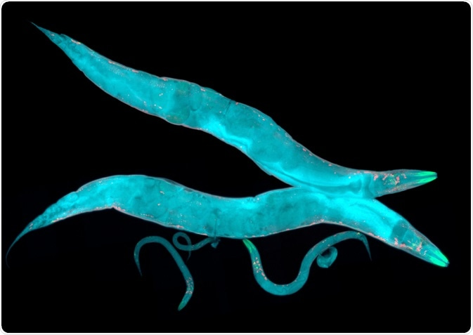
Caenorhabditis elegans is a species of nematode worm and is frequently chosen as a model organism to study human diseases.

Slide 15
What is C. elegans?
C. elegans is a species of nematode worm, and the adults are approximately 1mm in length with 959 somatic cells.
Its transparent body consists of three layers; an epidermal layer, an intestinal layer, and a muscle layer.
Other systems such as the nervous system and reproductive systems are found between the three layers.
This means that there are physiological overlaps between humans and C. elegans, such as the digestive system, the nervous system, and the reproductive system.
There have been observations that showed that C. elegans has the ability to recognize and react to things they do or do not like, indicative of a level of complex behavior.

Slide 16
The ability to self-fertilize is a useful tool for its use as a model organism, not only because these hermaphrodites can reproduce in high numbers quickly.
C. elegans can be grown in a petri-dish containing E. coli in the laboratory, as their natural diet is bacteria. Because of their small size, large numbers of C. elegans can be maintained in the laboratory without using a large number of resources.
It is also possible to maintain C. elegans in a “starved” state for months, or for longer storage it is possible to freeze C. elegans at -80°C.

Slide 17
C. elegans as a model for Parkinson’s disease
C. elegans as a model for mitochondrial diseases
C. elegans as a model for immunology

